Slide 1


MODFLOW 6 Framework and Groundwater Flow Model
47TH IAH Congress
São Paulo, Brazil
August 22, 2021
Notes:
Describe some of the ongoing work we are doing with MODFLOW
MODFLOW and related software distributed by the USGS is developed and supported by a growing team of USGS scientists and external collaborators. Recent MODFLOW development efforts have focused on use of unstructured and locally refined grids for constant or variable-density groundwater flow and solute transport simulation, robust handling of three-dimensional anisotropy, generalization and tracking of water transfer between packages, distributed memory parallelization, and consolidation of these core capabilities into MODFLOW 6. These capabilities make it possible to construct new types of models, such as tightly coupled nested models, that have not been possible with previous MODFLOW versions. Underlying these efforts has been the adoption of an open-development philosophy that relies on testing-based development and continuous integration practices by the core development team and by the broader MODFLOW community. Ongoing development increasingly relies on the Flopy python package for automating model construction. Resulting from these development efforts is a suite of MODFLOW programs that can be applied at local, regional, and National scales for a wide variety of complex groundwater flow and transport problems.
OASIS MCT

Slide 2
MODFLOW 6 Framework

Slide 3
MODFLOW Framework Components
MODFLOW-2005
MODFLOW 6

Slide 4
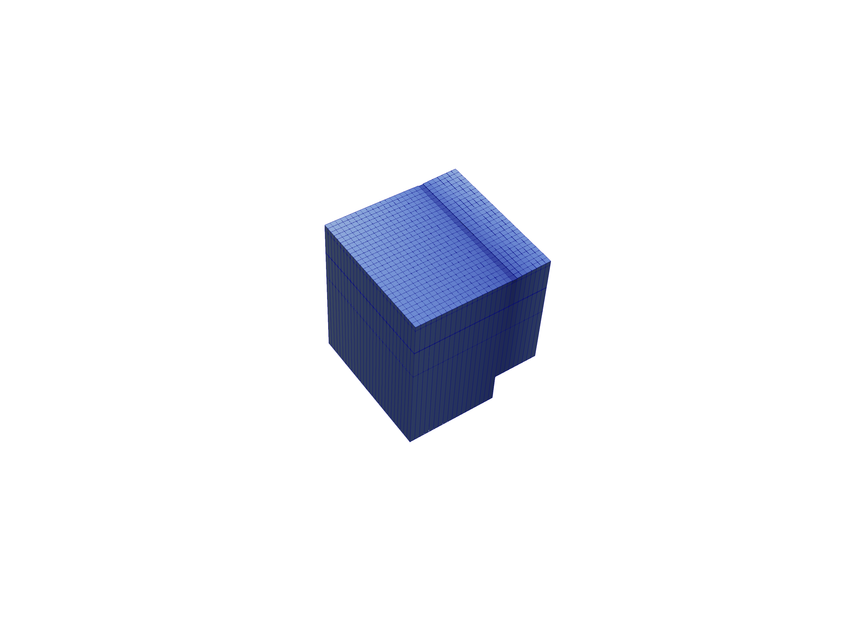
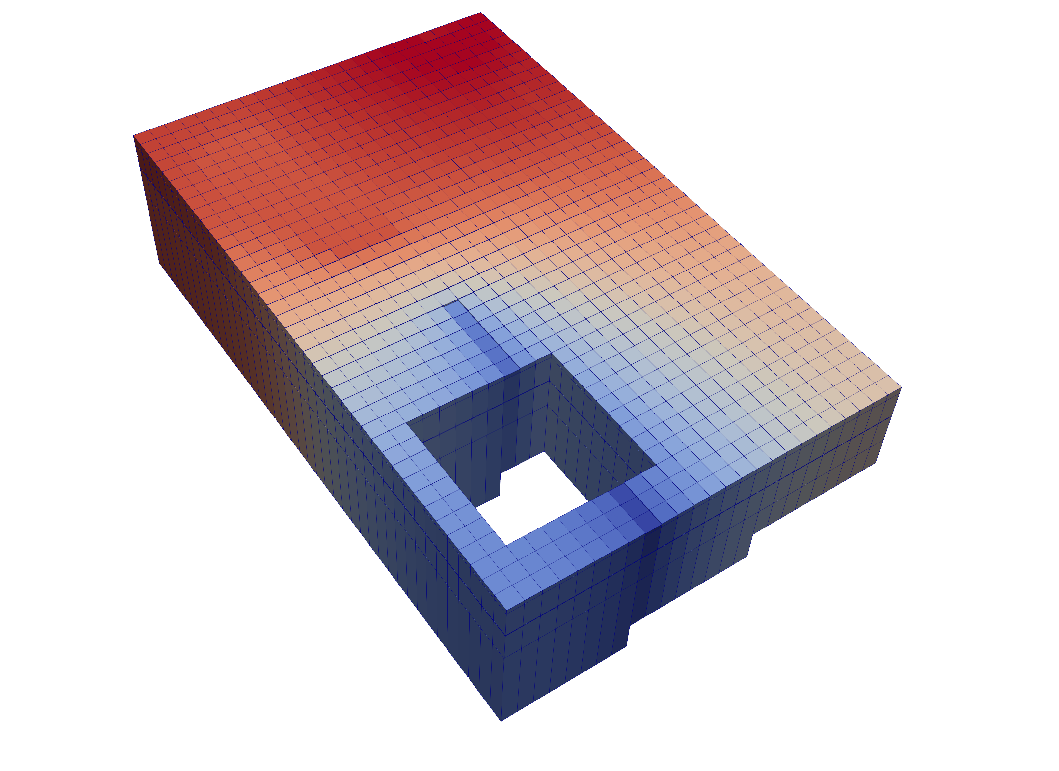
Multi-Model Coupling
Any number of models can be included in a simulation
Models coupled at matrix level
Flexibility supports coupling of parent, child, grandchild models, stacked models or adjacent models
Notes:
MODFLOW 6 consists of a "simulation"
Simulation can have any number of models in it
Multiple GWF Models, for example

Slide 5
Nested Grids
Parent
Child 1
Child 2
Grandchild

Slide 6
Multi-Level Grid Nesting
Notes:
Large scale and fine scale

Slide 7
MODFLOW 6 Framework Simulation Components
Simulation
Timing Module (TDIS)
One for all models
Stress-periods and timesteps
Adaptive timestep option
Solutions (IMS)
Model
GWF
GWT
Exchanges
GWF-GWF
GWF-GWT
GWT-GWT
Utilities
Timeseries
Observations
Timing Module
Solution 1
Model 1
Model 2
Model 3
Model 4
Exchange 1
Exchange 2
Exchange 3

Slide 8
MODFLOW 6 Framework Stress Period Data
BEGIN OPTIONS
PRINT_INPUT
PRINT_FLOWS
SAVE_FLOWS
END OPTIONS
BEGIN DIMENSIONS
MAXBOUND 42
END DIMENSIONS
BEGIN PERIOD 1
# canal
1 1 1 330.0
1 2 1 330.0
1 3 1 330.0
1 4 1 330.0
...
# river
1 1 20 320.0
1 2 20 320.0
1 3 20 320.0
...
END PERIOD
Stress are active until changed by the user
Different from previous MODFLOW versions
Can be specified using time series

Slide 9
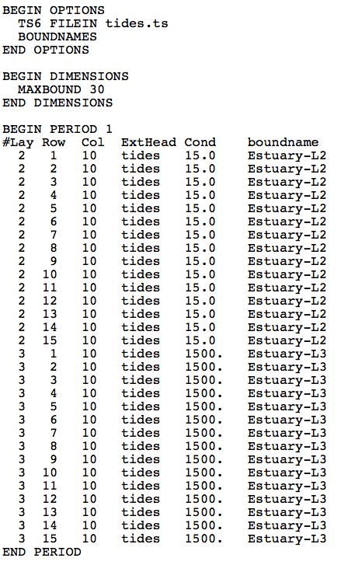
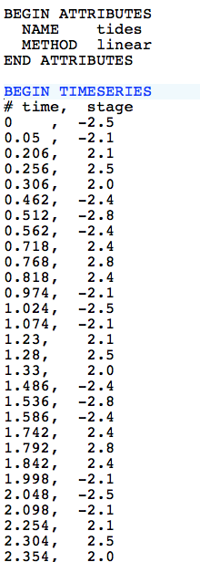
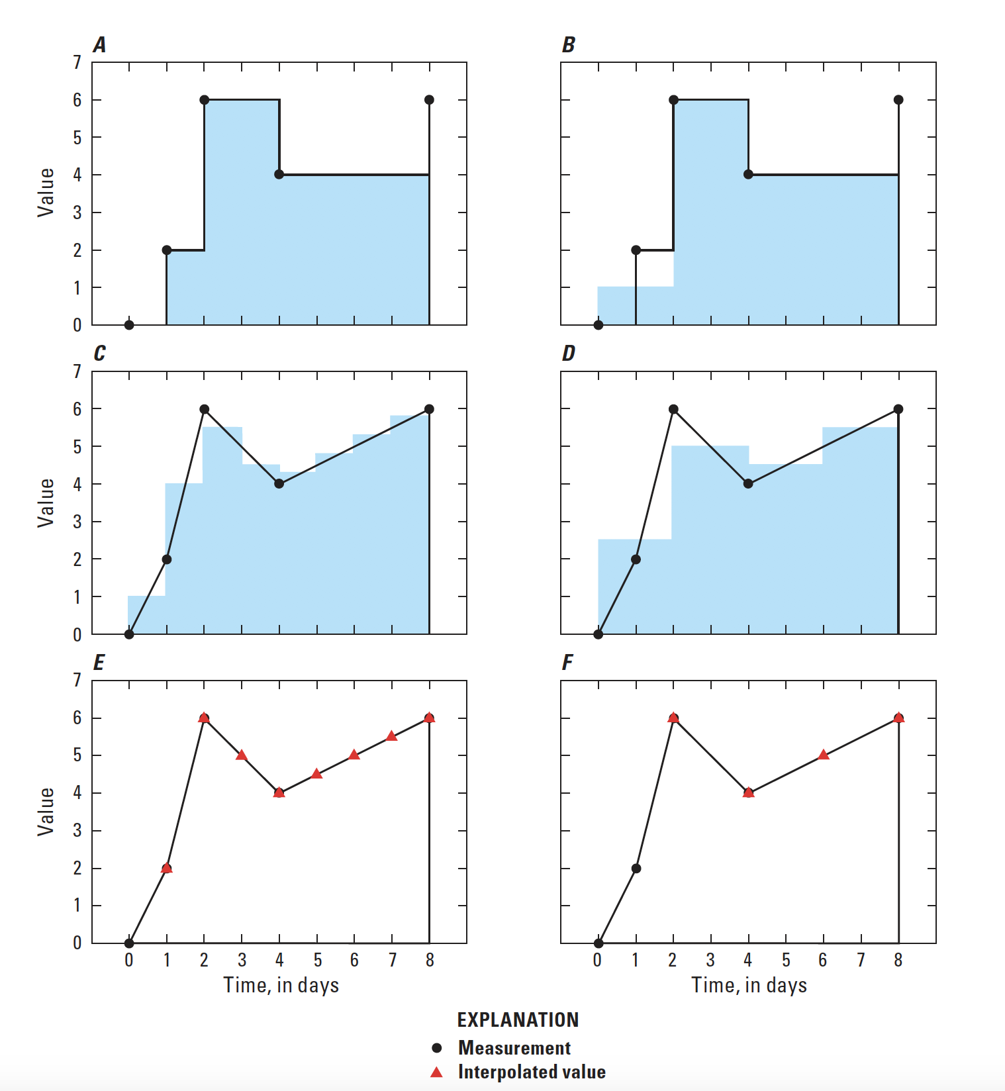
MODFLOW 6 Framework Time Series
GHB Input File
tides.ts
STEPWISE
Values are constant until changed
LINEAR
Average value is calculated for the time step
LINEAREND
Value interpolated at end of time step

Slide 10
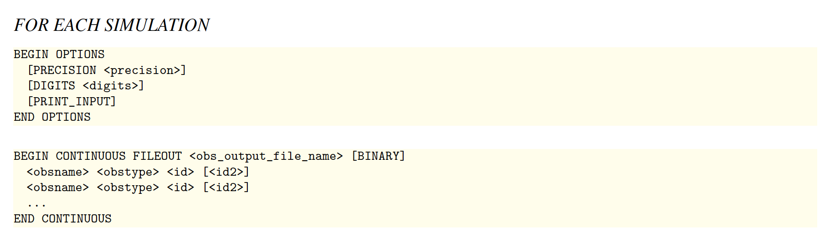
MODFLOW 6 Framework Observations
OBS Package for GWF Model
Heads
Flow between cells
Separate OBS files for each package

Slide 11
Groundwater flow (GWF) model

Slide 12
GWF Model Highlights
Generalized control-volume finite-difference formulation
Regular MODFLOW grids
Unstructured grids
IDOMAIN capability
Full 3D anisotropy
Multiple stress package ”instances”
Block and keyword input structure

Slide 13
Groundwater Flow (GWF) Model
Discretization (DIS, DISV, DISU)
Node Property Flow (NPF)
Storage (STO)
Specified Head (CHD)
General-Head Boundary (GHB)
Stream-Flow Routing (SFR)
Initial Conditions (IC)
Horizontal Flow Barrier (HFB)
Compaction and Subsidence (CSUB)
Well (WEL)
Drain (DRN)
Lake (LAK)
Output Control (OC)
Ghost Node Correction (GNC)
Recharge (RCH)
River (RIV)
Multi-Aquifer Well (MAW)
Observations (OBS)
Buoyancy (BUY)
Evapo-transpiration (EVT)
Unsaturated Zone Flow (UZF)
Water Mover
(MVR)
Data Input
Internal Flow
Internal Flow
Hydrologic Stress
Advanced Stress Package
Notes:
This is the structure of the GWF Model in MODFLOW 6
If you haven't used MODFLOW 6 before, it's very similar to previous MODFLOW versions; however,
We added a few things; we took a few things out.
We continuously ensure that MF6 gives the same answers as mf2005, mfnwt, mfusg (and if not, then why not)
MODFLOW 6 was developed as an object-oriented program:
To you, this means you can have more than one instance of certain things, like packages and models
Packages are objects, so we can have more than one package of the same type (when it makes sense). Not a big deal, but possibly useful
Simulation can have more than one GWF Model
LPF -> NPF, STO, ...

Slide 14
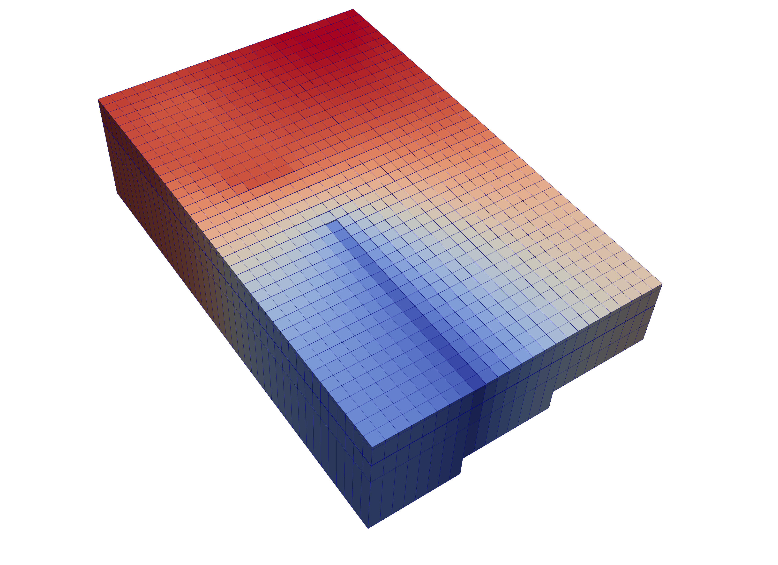
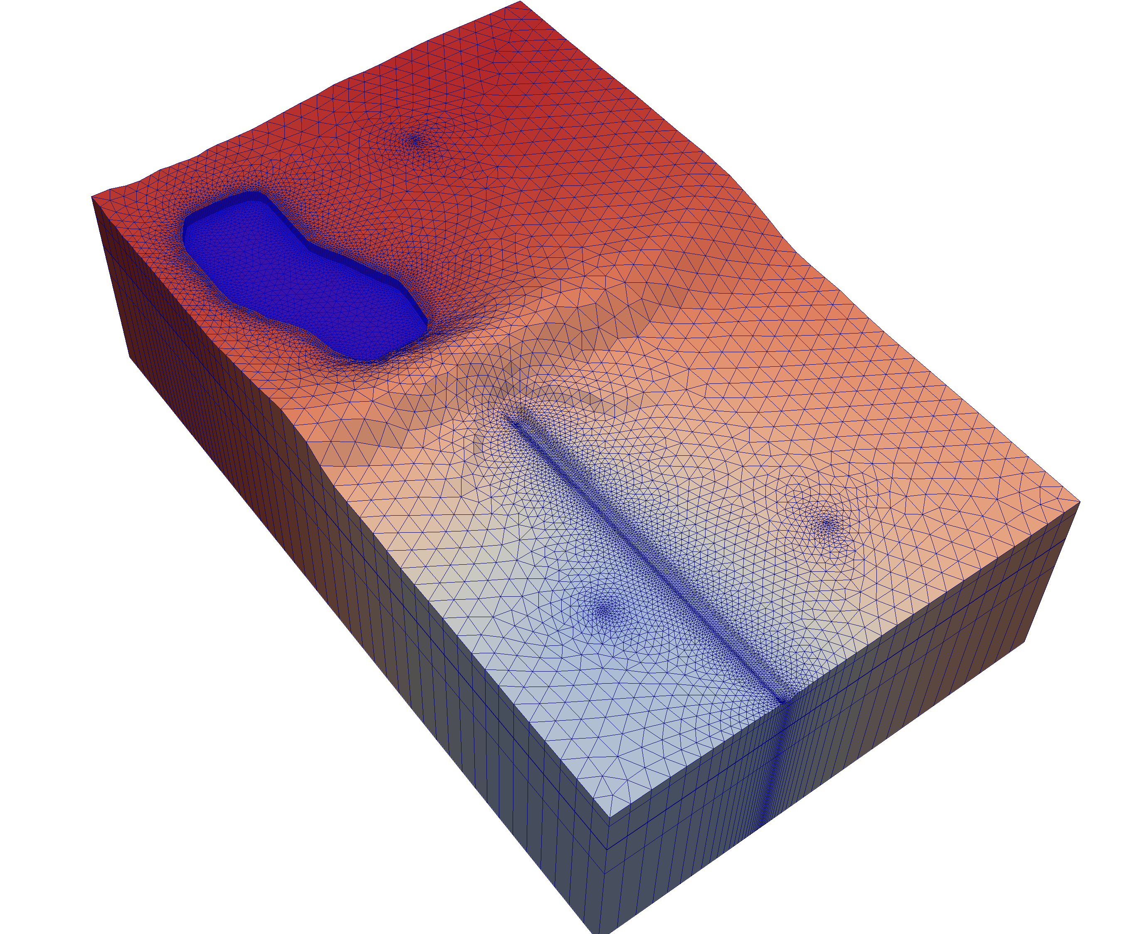
Regular or Unstructured Grids
3 Discretization Approaches
Regular MODFLOW grid (DIS)
Discretization by Vertices (DISV)
Generalized Unstructured (DISU)
Notes:
MODFLOW 6 has flexible options for grid design
Still highly recommend regular MODFLOW grids
For some problems, an unstructured grid might offer some powerful capabilities for adding refinement around features of interest
This is a model that we teach with in one of our classes
The triangular mesh allows refinement around the lake, stream, and wells to better represent hydraulic gradients

Slide 15
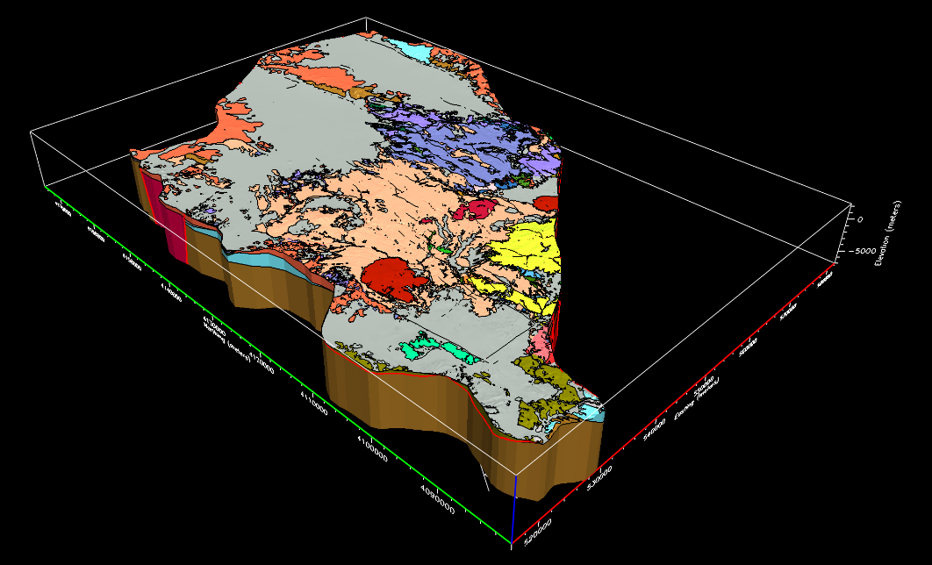
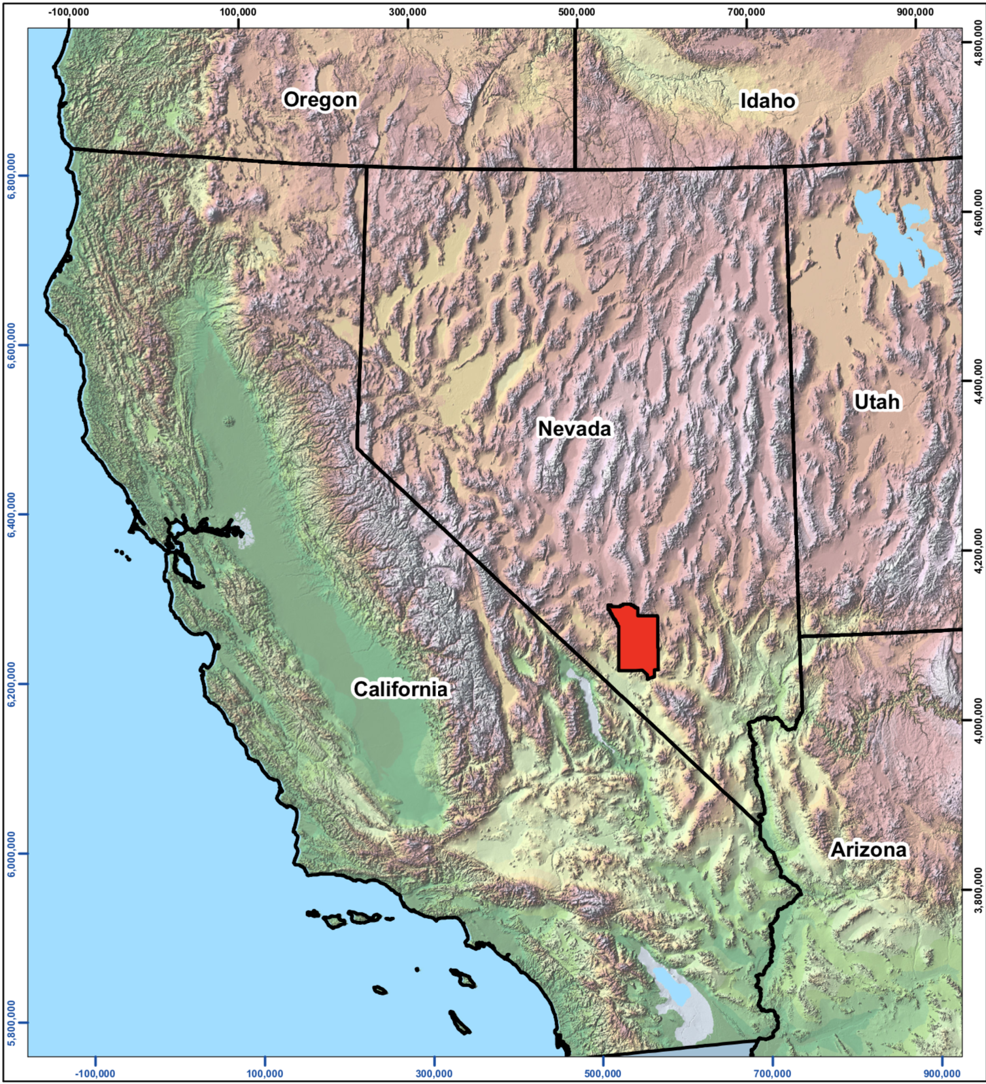
Pahute Mesa - Oasis Valley Example
Nevada National Security Site
Navarro Research and Engineering Inc. funded by DOE
Develop a groundwater flow model for scenario testing
Notes:
MODFLOW 6 has been out now for over 3 years and is being used
Here is an example of an application in Nevada
Where radionuclides are present in the subsurface and there is interest in simulating and predicting their fate

Slide 16
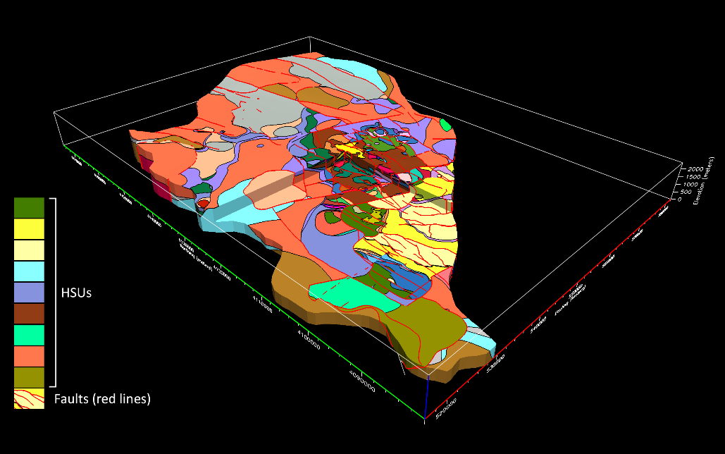
Hydrostratigraphic Framework Model
77 hydrostratigraphic units
98 faults and structural features
Convert Earthvision hydrostratigraphic model into a MODFLOW 6 GWF model
Notes:
Hydrostratigraphic framework model
Based on:
U.S. Department of Energy Environmental Management Nevada Program. 2020. Pahute Mesa-Oasis Valley Hydrostratigraphic Framework Model for Corrective Action Units 101 and 102: Central and Western Pahute Mesa, Nye County, Nevada, Rev. 0, DOE/EMNV--0014. Las Vegas, NV.
Fenelon, J.M., K.J. Halford, and M.T. Moreo. 2016. Delineation of the Pahute Mesa-Oasis Valley Groundwater Basin, Nevada, Version 1.1, Scientific Investigations Report 2015-5175. Carson City, NV: U.S. Geological Survey.

Slide 17
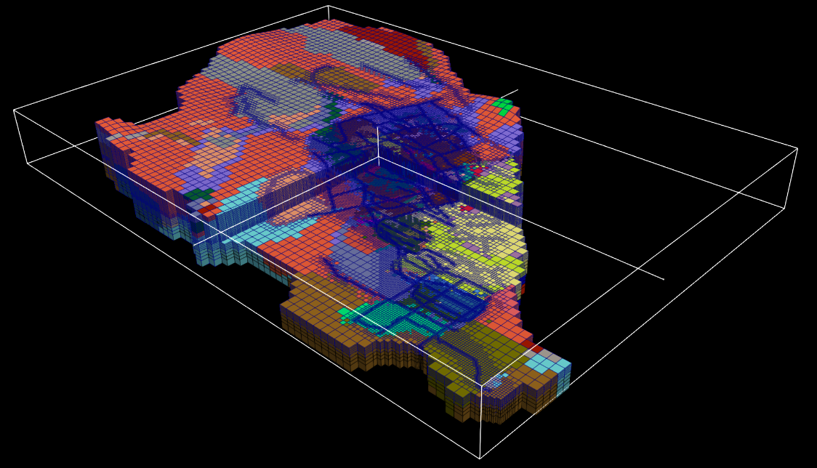
MODFLOW 6 Model
Python and the FloPy Package used to convert Earthvision hydrostratigraphic model into MODFLOW 6 model
Notes:
This is a 3D representation of their MODFLOW 6 model grid
Quadtree grid, in which some cells are divided into 4.
These guys used python and FloPy to wrangle the hydrogeologic framework model into a MODFLOW 6 model

Slide 18
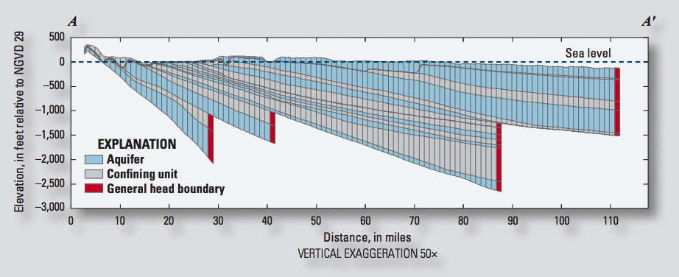
IDOMAIN Capability
Improve efficiency for models with large areas of inactive cells
Address MODFLOW limitations with discontinuous hydrogeologic layers

Slide 19
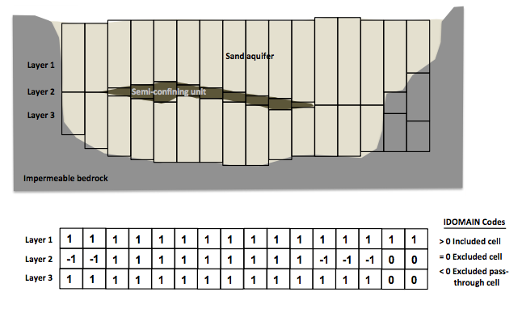
IDOMAIN Capability (cont.)
Permanently remove a cell from the simulation
Can be used with DIS and DISV
Optionally connect overlying and underlying cells

Slide 20
Node Property Flow (NPF) Package
Primary purpose is to calculate conductance between adjacent cells
Confined or convertible cells (ICONVERT)
Homogeneous or heterogenous
Isotropic or anisotropic
Handles wetting and drying (REWET, WETDRY) (still available, but the Newton-Raphson method is much better)
Can calculate the three components of specific discharge at the cell center (SAVE_SPECIFIC_DISCHARGE). Nice for vector plots, and required for transport.

Slide 21
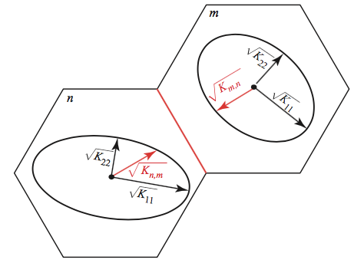
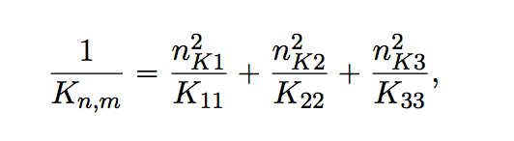
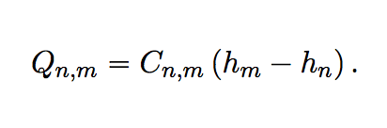
Effective Conductivity Approach
Large errors for certain ellipsoid configurations
Approximate, but relatively fast
Simple to implement

Slide 22
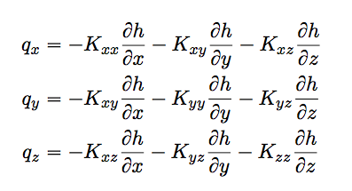
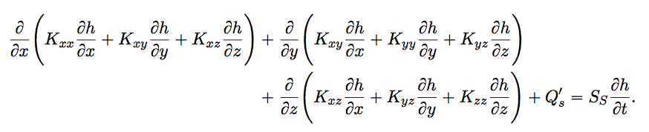
XT3D Approach
General and robust handling of anisotropy
Computationally expensive
Requires more memory (larger stencil)
Longer runtimes
RHS option available to reduce memory usage
Option to limit use of XT3D to specific cell connections
Improves flow solution for certain grid types
More on this later

Slide 23
Newton-Raphson Formulation
Standard Formulation approach:
Dry cells are inactivated. This creates discontinuities and oscillations. Furthermore, wetting/drying results in varying stresses (for example, wells disappear from dry cells).
Newton-Raphson Formulation approach:
Keep all cells active even when the head in a cell is below the bottom of the cell

Slide 24
Newton-Raphson Formulation
Is generally more robust than the Standard Formulation for strongly non-linear problems (water table conditions)
Upstream weighting used
Smoothing applied to horizontal conductance
Constant vertical conductance
Newton-Raphson terms result in an asymmetric matrix and requires different linear accelerators

Slide 25
Newton-Raphson Formulation
Once Newton-Raphson is enabled in the GWF name file Newton-Raphson is also used for GWF terms formulated by
Storage Package
Well Package (auto flow reduce)
Lake Package*
Multi-aquifer Well Package
Streamflow Routing Package*
Unsaturated Zone Flow Package*
* Advanced stress package continuity equation also solved using Newton-Raphson

Slide 26
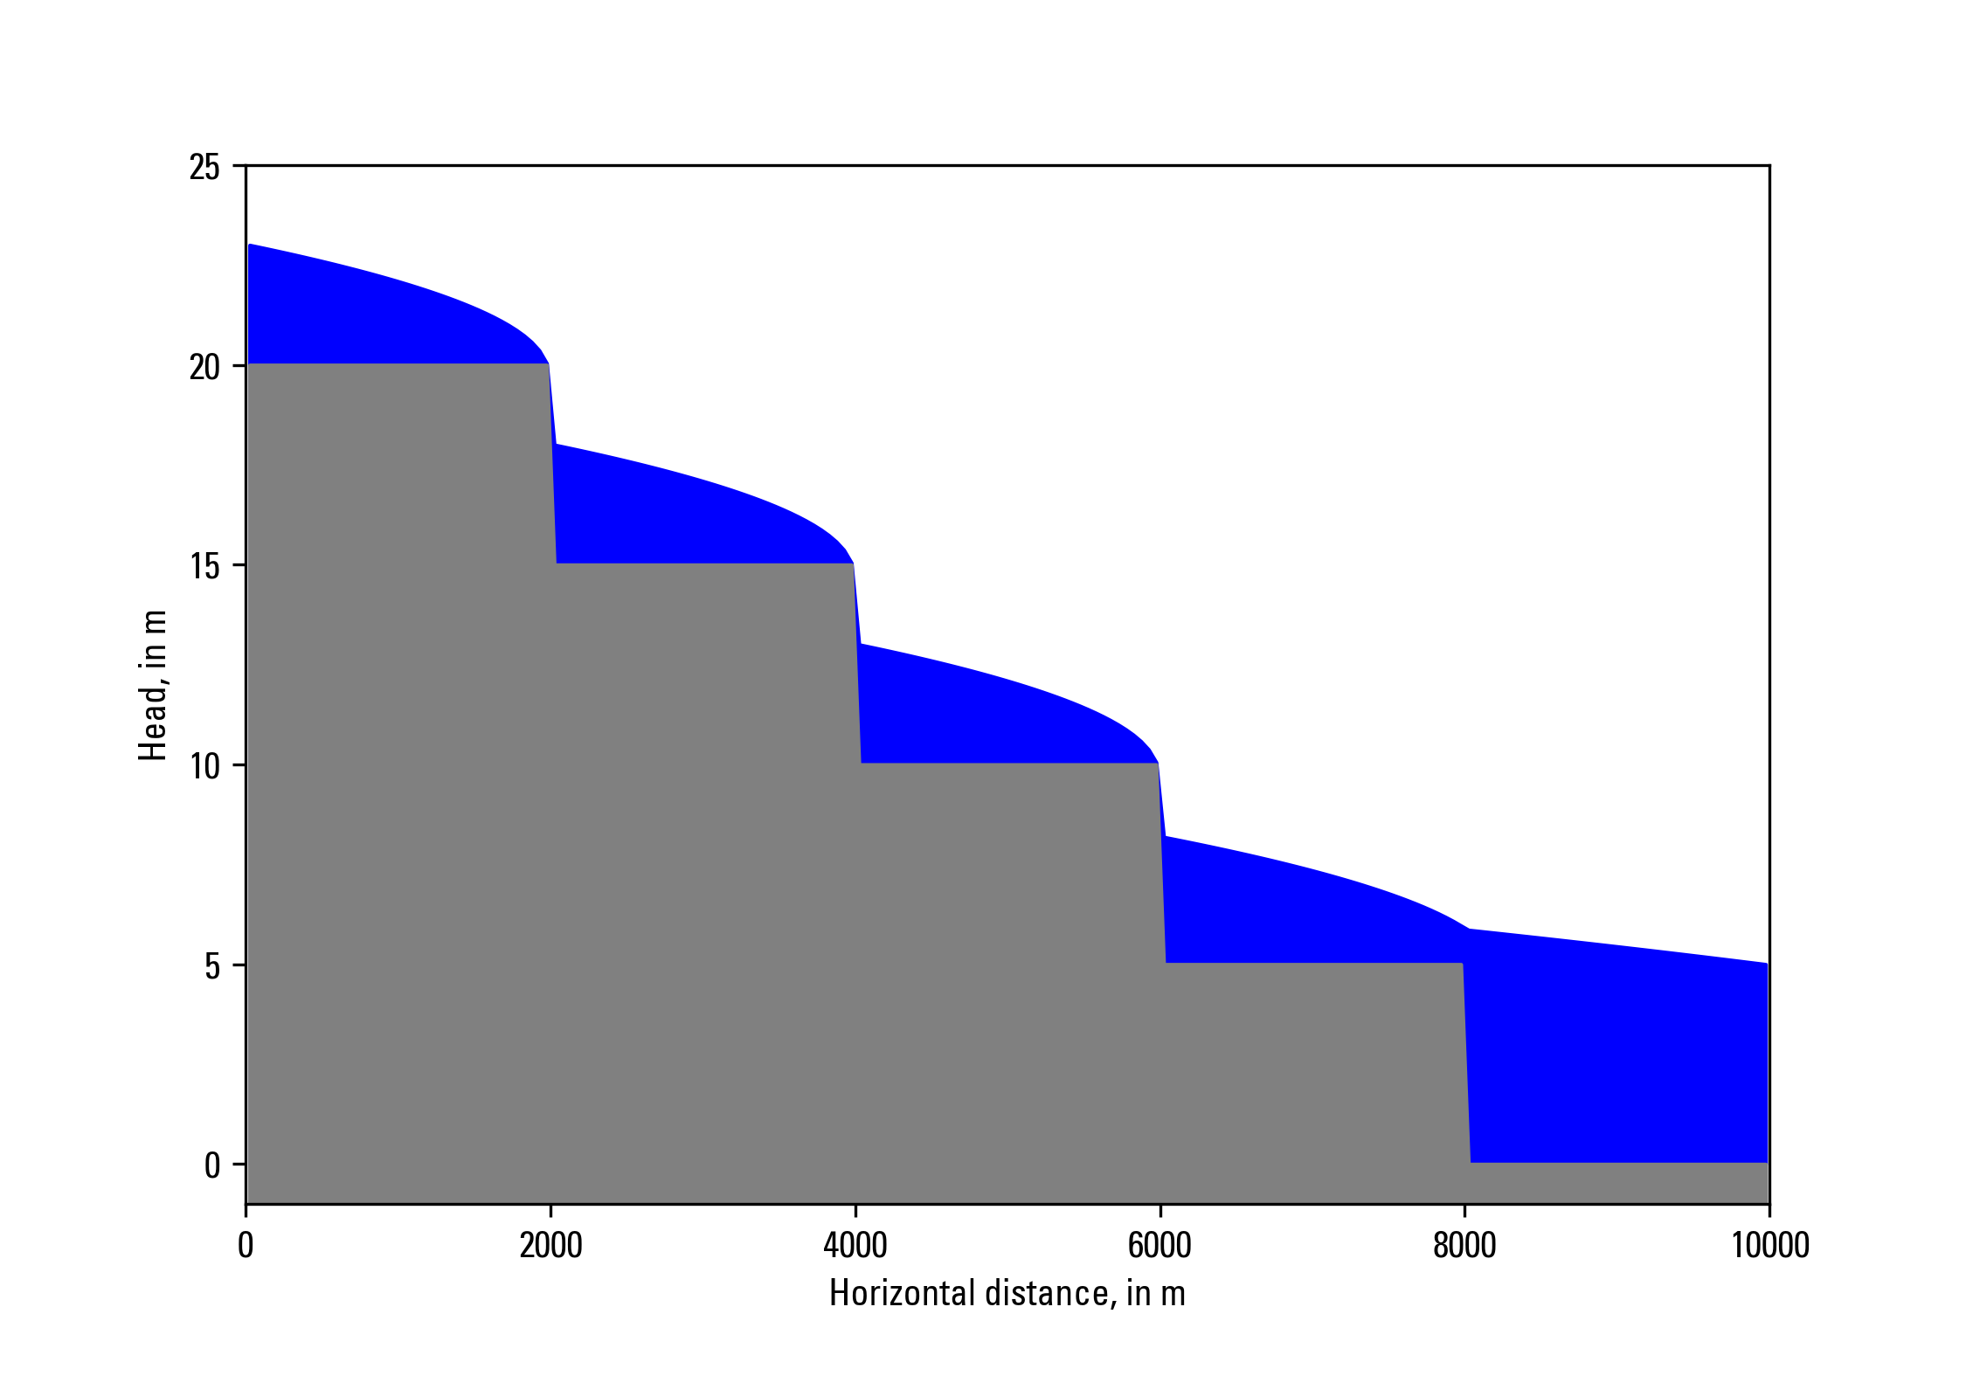
Newton-Raphson Formulation
Zaidel, Jacob, 2013, Discontinuous steady-state analytical solutions of the Boussinesq equation and their numerical representation by MODFLOW: Groundwater, v. 51, p. 952–959. doi: 10.1111/gwat.12019.

Slide 27
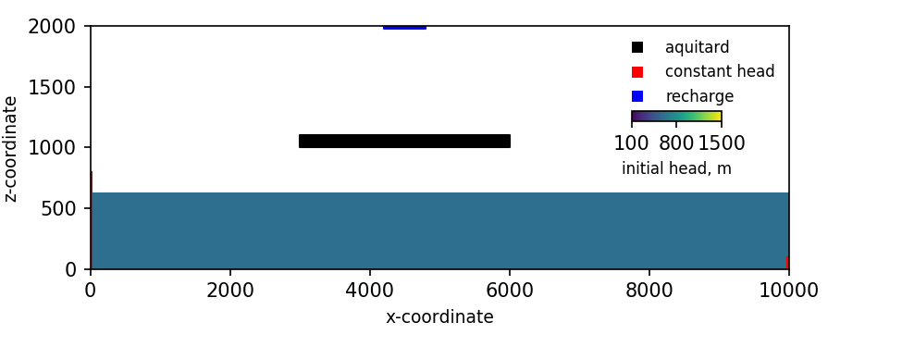
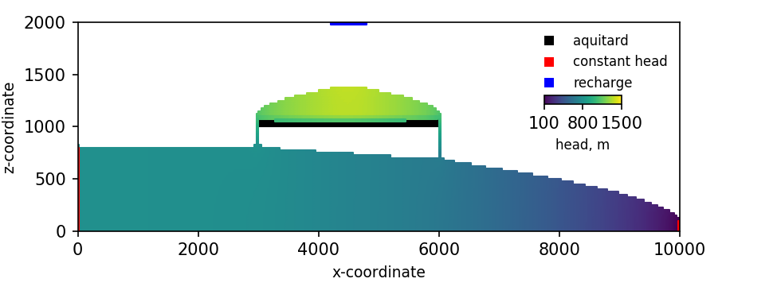
Newton-Raphson Formulation
Keating, Elizabeth, and Zyvoloski, George, 2009, A stable and efficient numerical algorithm for unconfined aquifer analysis: Ground Water, v. 47, no. 4, p. 569–579, accessed June 27, 2017, at https://doi.org/10.1111/ j.1745-6584.2009.00555.x.

Slide 28
Storage (STO) Package
Steady state if STO Package not specified for a simulation
Cells are treated as confined or convertible (ICONVERT)
Aquifer storage properties (SS and SY) are specified
Individual stress periods are marked as steady state or transient

Slide 29
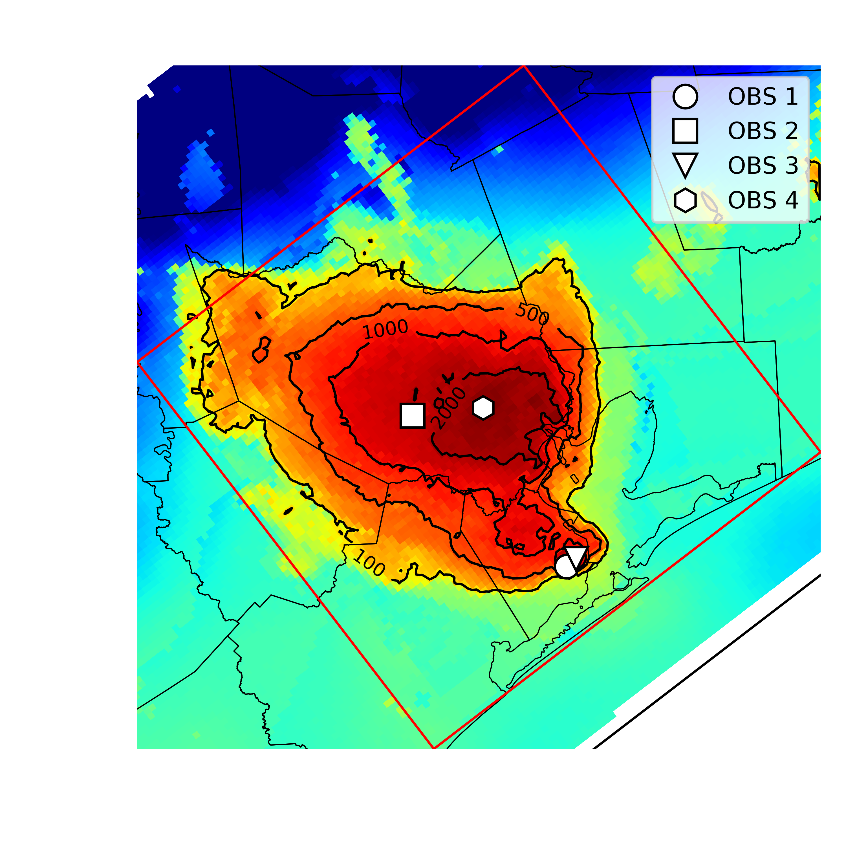
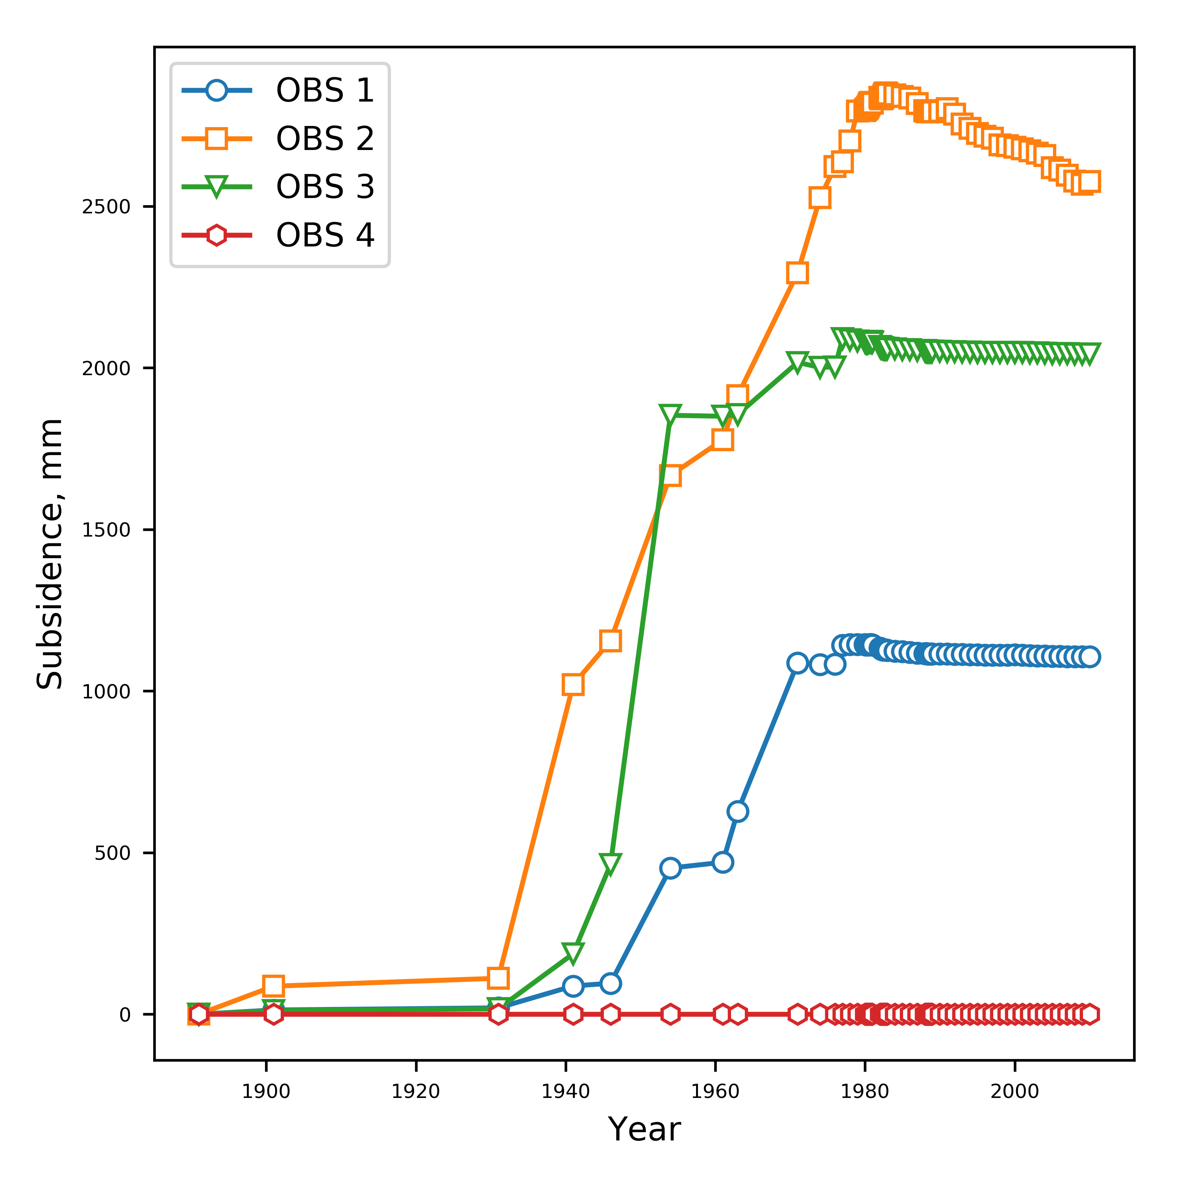
Compaction and Subsidence (CSUB) Package
Package based on MODFLOW-2005 SUB and SUB-WT Packages
Effective stress formulation
Effective stress dependent storage properties
Water table dependent compaction
Elastic and inelastic compaction of fine-grained sediments
No-delay (thin beds that equilibrate quickly)
Delay (thick beds that drain slowly – separate numerical solution)
Can account for elastic compaction of coarse-grained aquifer materials and water compressibility (full storage equation)

Slide 30
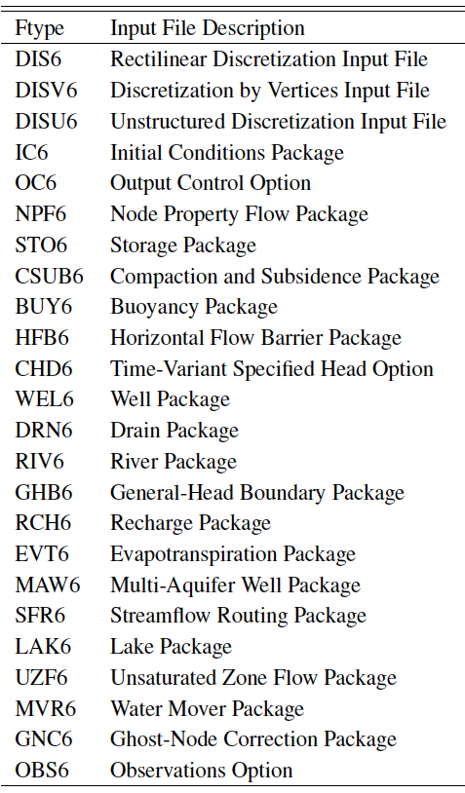
GWF Stress Packages
More than one per model
Advanced packages

Slide 31
Traditional Stress Packages
Specified head (CHD) Package
No more IBOUND. Must use CHD
Can turn CHD cells on and off by stress period
Well (WEL) Package
Recharge (RCH) Package
Array-based or list based
River (RIV) Package
General-Head Boundary (GHB) Package
Drain (DRN) Package
Evapotranspiration (EVT) Package
Array-based or list based

Slide 32
Advanced Stress Packages
Solve a separate continuity equation*
Require discretization definition*
Require parameter definition
Require connectivity definition
Require specification of boundary stresses*
Separate budgets and output files
*does not apply to Mover (MVR) package

Slide 33
Advanced Packages
Multi-Aquifer Well (MAW) Package
Stream-Flow Routing (SFR) Package
Lake (LAK) Package
Unsaturated Zone Flow (UZF) Package
Water Mover (MVR) Package

Slide 34
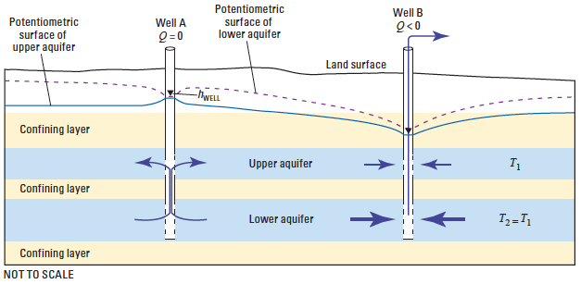
Multi-Aquifer Well (MAW6) Package
Capabilities
Solved as part of the matrix solution
Simplified data input
Flexible connectivity
Several well conductance formulations
Constraints (flow reduction and well shutdown) and flowing well options
Can account for interbore storage changes
Constant and inactive wells
Differences
Currently no support for
horizontal wells
partial penetration
non-linear head losses

Slide 35
Streamflow Routing (SFR6) Package
Capabilities
multiple diversions from a single reach
downstream outflow from a reach to multiple segments using user-specified time-varying discharge fractions.
diversion priority scheme can be implemented based on diversion order
Inactive reaches
rectangular reaches
stream data are specified by reach
explicitly defined reach connectivity
currently no UZF under reaches
no Kinematic Routing (no reach storage changes)

Slide 36
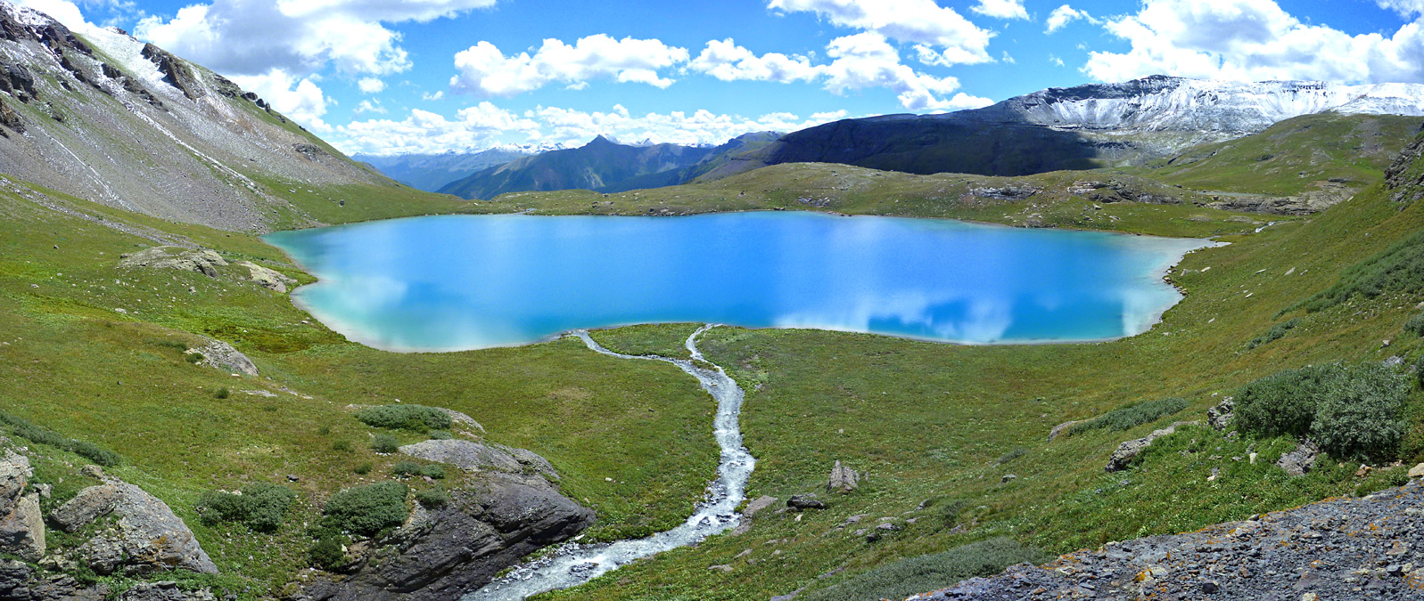
Lake (LAK6) Package Capabilities
Capabilities
multiple outlets per lake using 3 outlet equation options (specified, Manning, weir)
lakes on top of model (overlying), incised lakes, embedded lakes (sub-grid scale lakes)
constant stage and inactive lakes
explicitly defined lake connectivity
currently no UZF under lakes

Slide 37
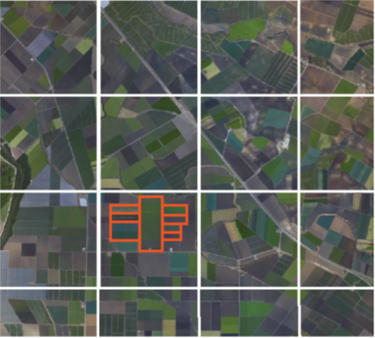
Unsaturated Zone Flow (UZF6) Package
Intended for basin scale studies
Simulates:
Kinematic-wave approximation of Richards’ equation
ET (unsaturated and saturated)
Spring discharge (groundwater discharge to land surface)
Saturation excess (rejected infiltration)

Slide 38
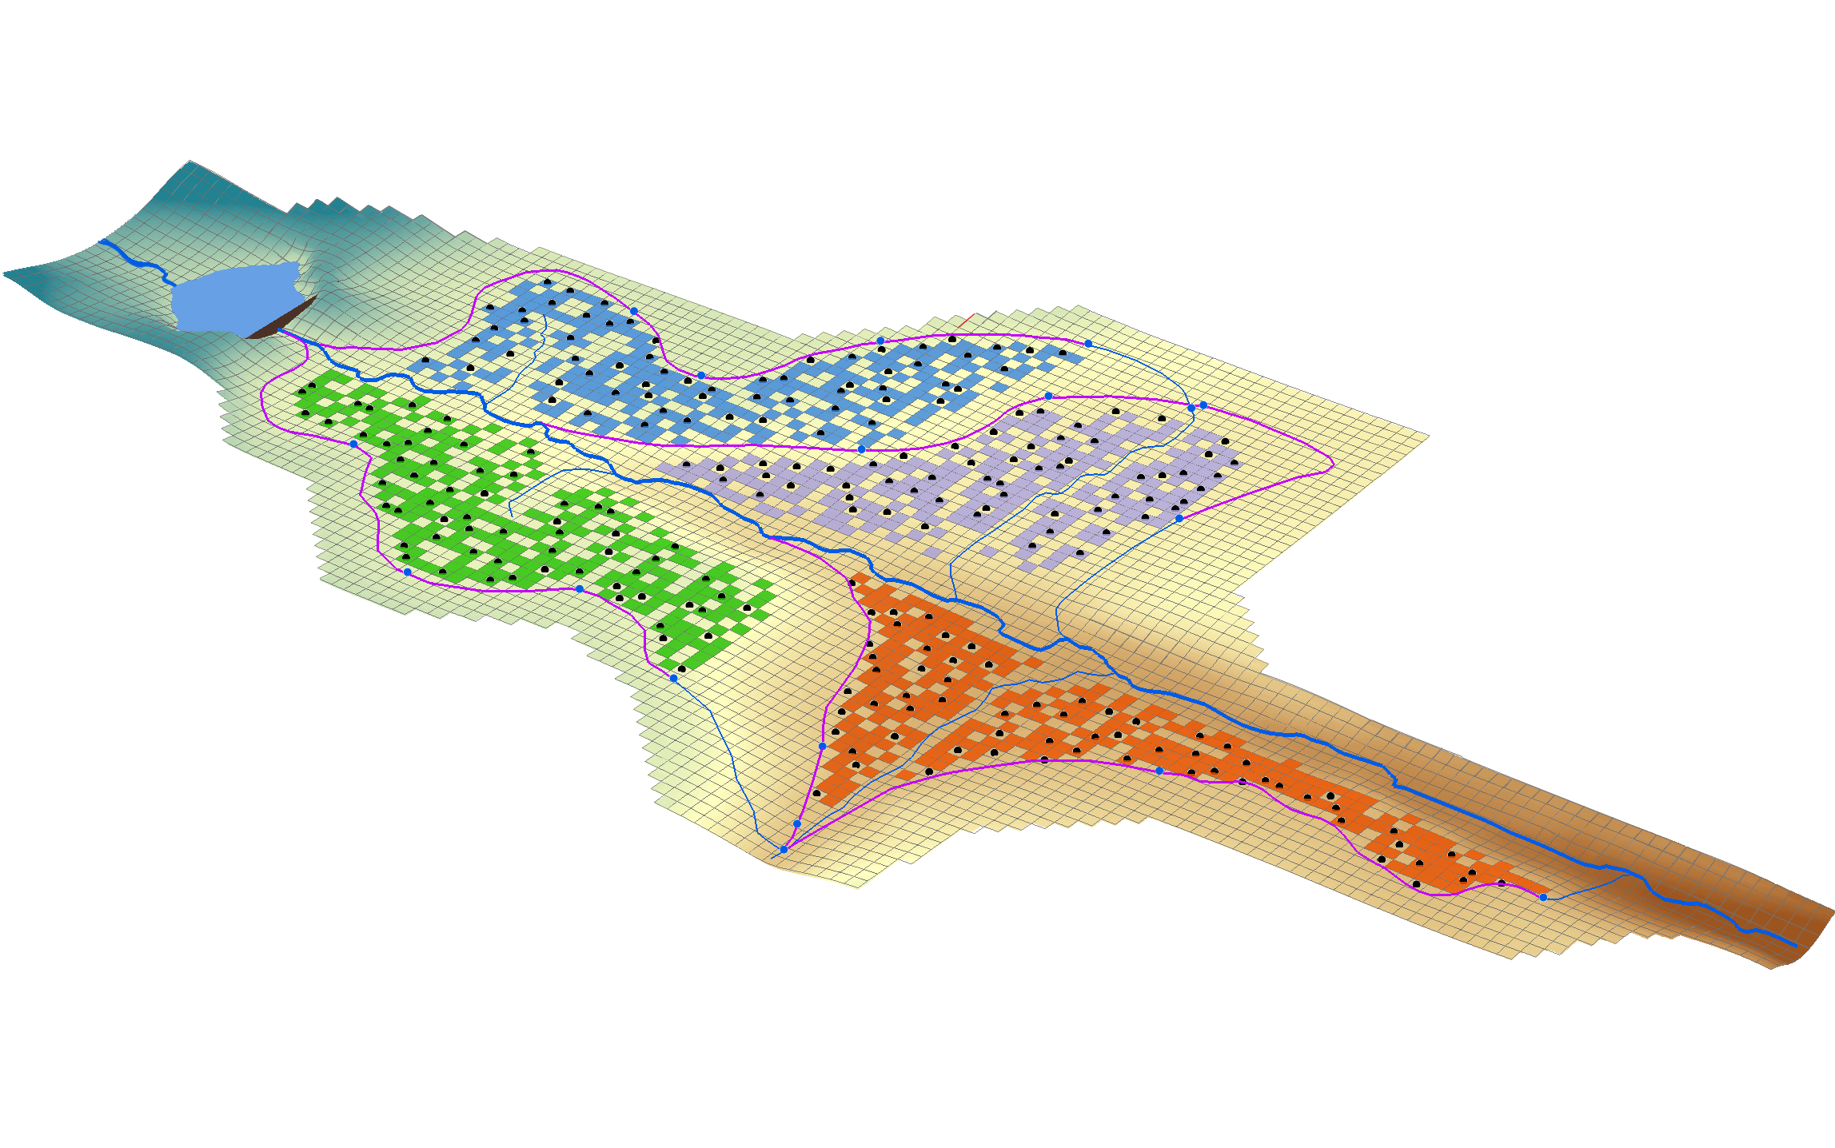
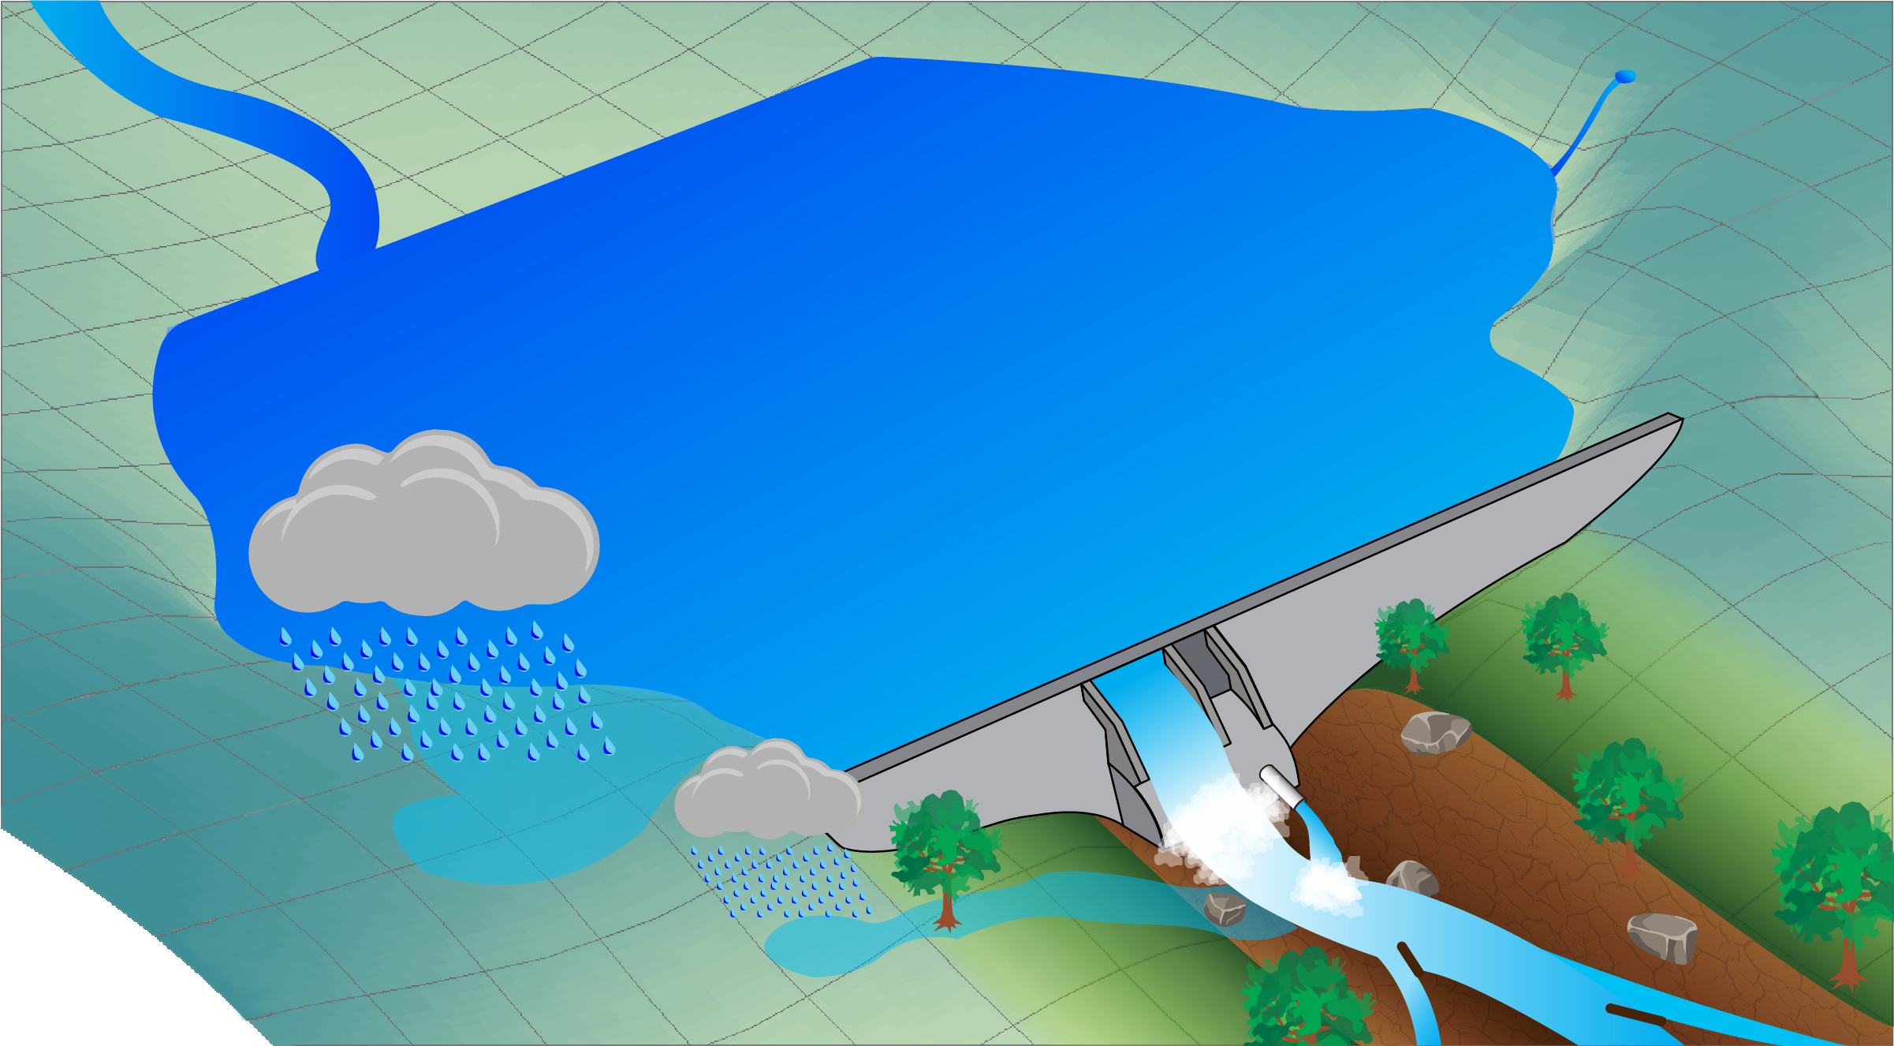
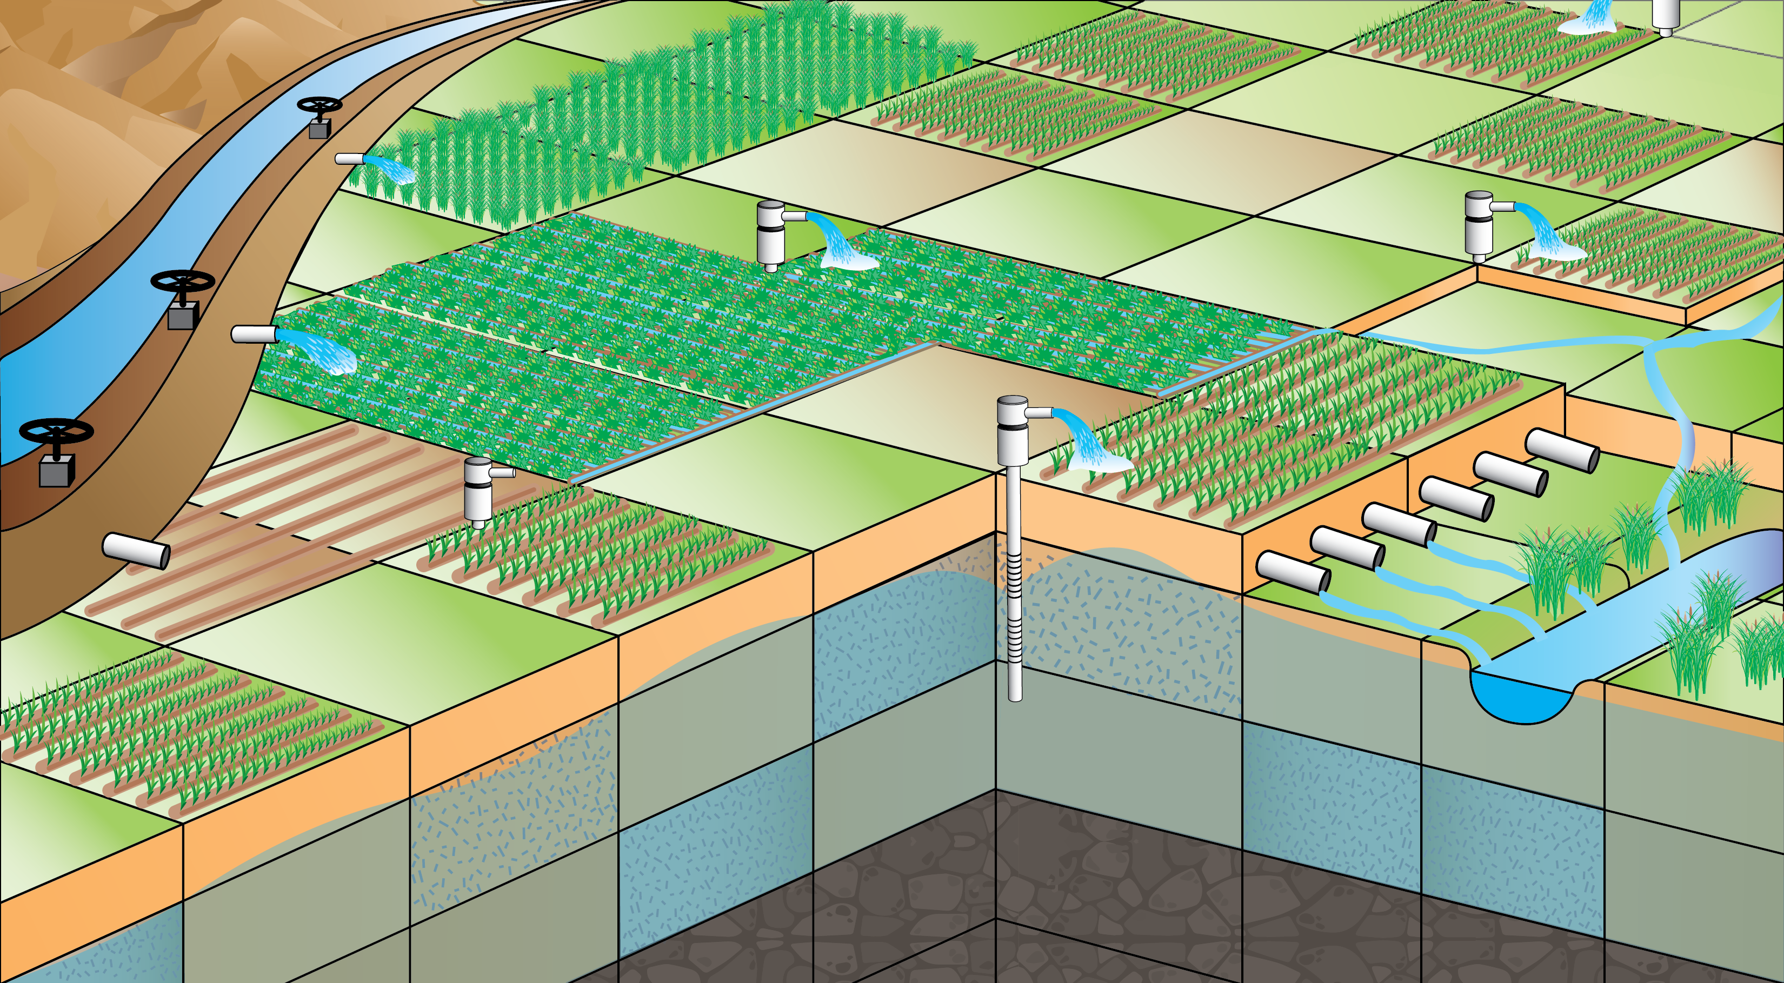
Water Mover (MVR6) Package
Generalized package for transferring water from one MODFLOW package to another
Water can be transferred from a “provider” to a “receiver” subject to simplified rules
All transfers are tracked in a water budget
Notes:
MODFLOW was originally developed on the concept that packages are independent from one another!
This made it difficult to represent flow between packages (River flowing into a lake)
And if you look now, many of the MODFLOW variants have complicated inter-package water movement
We introduced the concept of a Water Mover Package
Can take water from providers and send it to receivers, subject to some simple rules
Providers are most stress packages
Receivers are only LAK, SFR, MAW, UZF
Example: so if you have drains/seepage face you can route that water into a stream or lake
This is all tracked and stored (might need it for transport!)

Slide 39
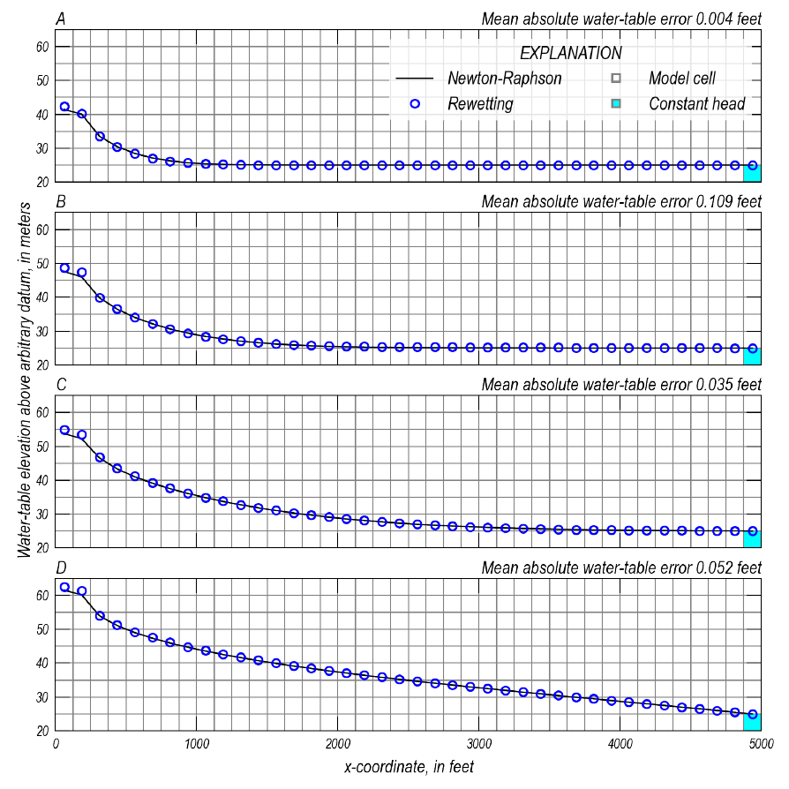
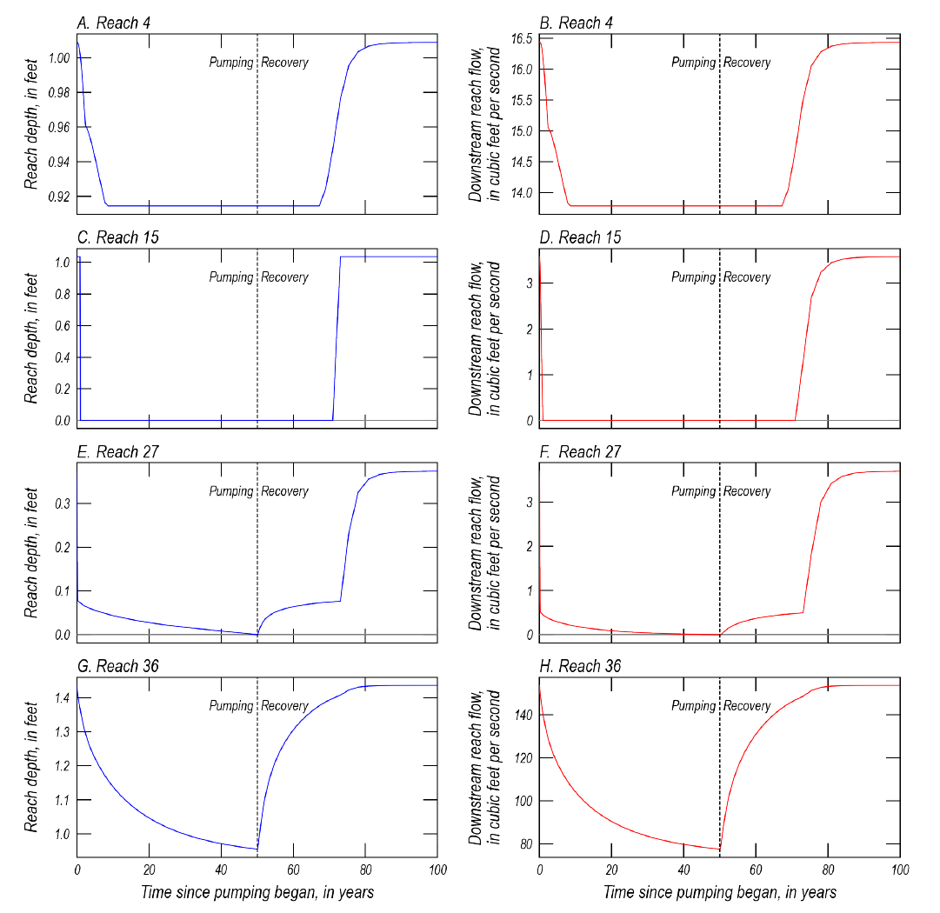

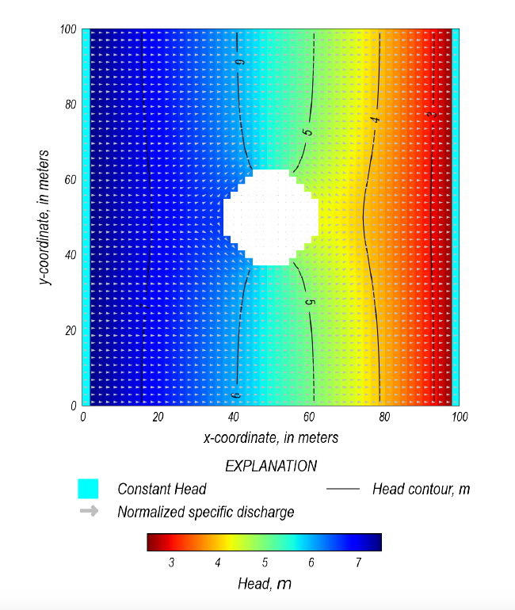
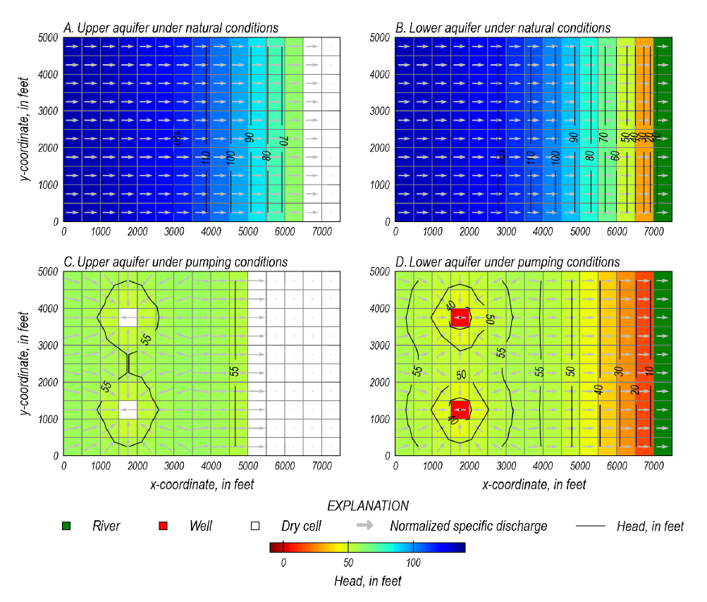
Examples Document

Slide 40
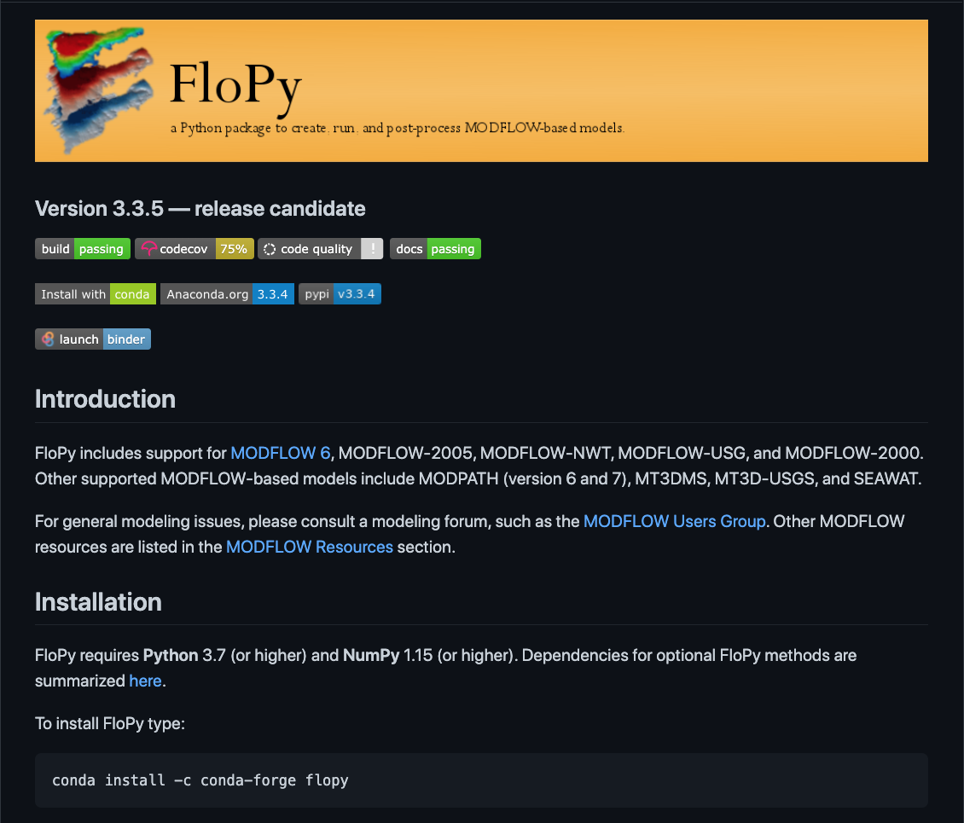
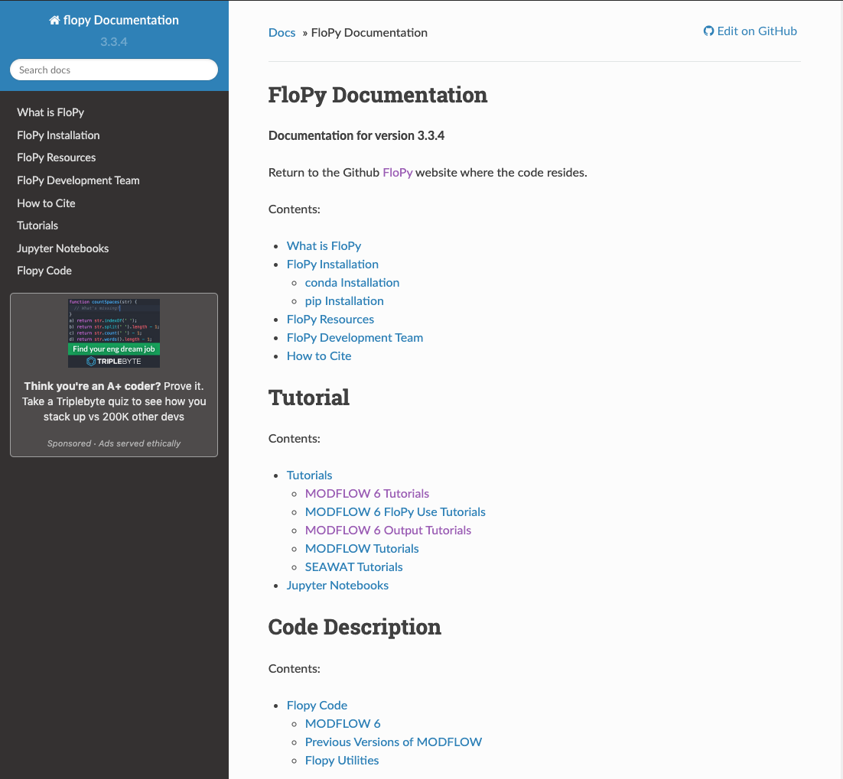
FloPy
Notes:
MODFLOW was originally developed on the concept that packages are independent from one another!
This made it difficult to represent flow between packages (River flowing into a lake)
And if you look now, many of the MODFLOW variants have complicated inter-package water movement
We introduced the concept of a Water Mover Package
Can take water from providers and send it to receivers, subject to some simple rules
Providers are most stress packages
Receivers are only LAK, SFR, MAW, UZF
Example: so if you have drains/seepage face you can route that water into a stream or lake
This is all tracked and stored (might need it for transport!)

Slide 41
Any Questions?

